Slide 1

Gender Pay Report
Circet Networks Ireland LTD & Circet Installs Ltd - Dec 2024

Slide 2

SUMMARY
Circet is Europe’s largest telecommunications provider with over 15,000 employees working across 11 countries in Europe, the UK and the United States of America. In Ireland Circet has over 2,200 employees, with Company headquarters located in Clondalkin, Dublin 22.
Since 2022, Circet have been reporting on its Gender Pay Gap. The gender pay gap identifies the difference between the average pay of all men and women, irrespective of the role that they perform. It is measured on mean and median percentage. The mean data percentage is the difference between the average hourly earnings for men and women across all roles. The median data percentage is the difference in hourly earnings between the “middle woman” and “middle man”. The gender pay gap does not show the difference between men and women in the same role or equivalent work, which is referred to as equal pay.
It is important to also acknowledge that whilst we are required to report on the gender pay gap between male and female colleagues, some of our colleagues identify as non-binary, trans and gender non-conforming.
The details contained in this Gender Pay Report are accurate and meet the requirements of The Employment Equality Act 1998 (Section 20A) Gender Pay Gap Regulations 2022.

Slide 3
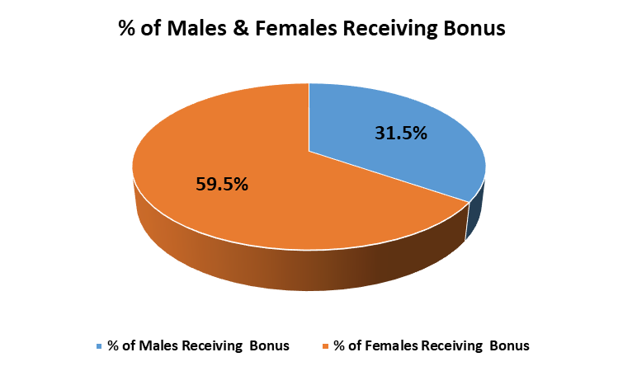
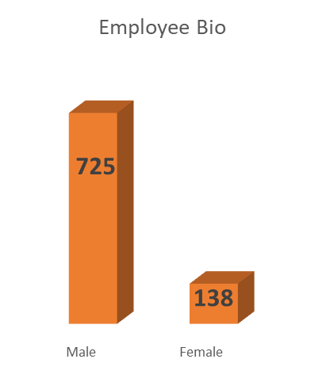
Gender Pay Findings – Circet Networks Ireland Ltd
The mean gender pay gap identifies that the average hourly pay for males is 18.3% higher than for females. This is due to the composition of our workforce and the type of role undertaken.
The median gender pay gap is 26.2% that the “middle male” earns 26.2% more than the “middle female”.
In terms of bonus 59.5% of females received a bonus compared to 31.5% of males. This is predominantly due to the nature of the roles females are engaged in versus those of their male colleagues.
Mean Gender Pay Gap % | Median Gender Pay Gap %
18.30% | 26.20%
Mean Bonus Gender Pay Gap % | Median Bonus Gedner Pay Gap %
27.50% | 25.00%

Slide 4
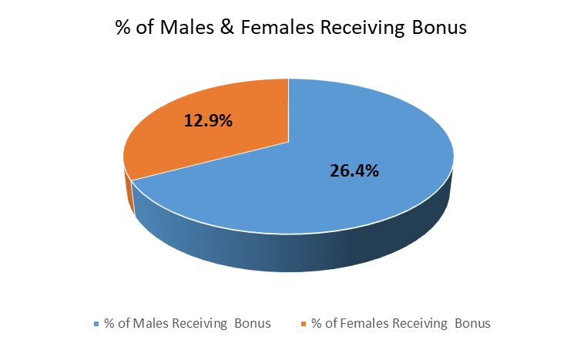
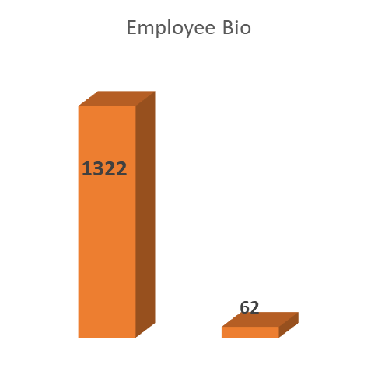
Gender Pay Findings – Circet Installs Ltd
The mean gender pay gap identifies that the average hourly pay for males is 36.3% higher than for females. This is due to the composition of the workforce and the type of job roles undertaken.
The median gender pay gap % is 41.8% meaning that the “middle male ” earns more than the “middle female”.
In terms of bonus payments 26.4% of males received a bonus payment compared to 12.9% of females. The bonus gap continues to be guided by the larger proportion of males in senior roles and field-based roles which typically have a higher bonus opportunity. This is predominantly due of the nature of the role's females are engaged in versus those of their female colleagues

Slide 5
How we plan to lessen the Gender Pay Gap
Fair and transparent recruitment process – As an equal opportunities' employer, we continue to monitor the recruitment and selection process to ensure that there is no bias and furthermore that we promote a culture of equality. We strive to ensure that all promotion opportunities available are advertised and that all persons have the same equal opportunity to apply.
Continue to build our Women in Circet network – We have successfully implemented a Women in Circet Resource team to address the challenge of attracting and retaining women into our business to encourage more female leaders in the business and to lessen the gender pay gap with the aim of promoting more women into senior management roles.
Hybrid/Flexible Working – Hybrid working is currently ongoing across the group, with flexible options to combine office and home working.
Learning and Development – Circet are committed to providing ongoing learning and developmental opportunities so that all employees can develop to their full potential. We also continue to educate employees on diversity and inclusion through the roll out of policy and workshops.
Enhanced benefits/maternity package – We will continue with our Company-wide communication strategy using the communication and marketing team to ensure all employees are aware of the benefits that Circet Ireland & UK offer, in particular our enhanced maternity leave payment

Slide 6
Gender Pay Report
Circet Ireland LTD - December 2023

Slide 7
Gender Gap Report Findings – Circet Networks Ireland Ltd
Representation Per Quartile
Gender | Upper | Upper Middle | Lower Middle | Lower
Male | 87% | 95% | 90% | 66%
Female | 13% | 5% | 10% | 34%
Mean Gender Pay Gap % | Median Gender Pay Gap %
14.60% | 25.60%
Mean Bonus Gender Pay Gap % | Median Bonus Gender Pay Gap%
27.10% | 0.00%
On average, men and women have comparable earning potential, with a difference of 14.60% in favor of men.
The number of females who received a bonus was 56.9% compared to 32.4% of males. This is predominantly due to the nature of the roles females are engaged in verses those of their male colleagues.

Slide 8
Gender Gap Report Findings – Circet Installations Division
Representation Per Quartile
Gender | Upper | Upper Middle | Lower Middle | Lower
Male | 98% | 99% | 97% | 81%
Female | 2% | 1% | 3% | 19%
Our Installations Division is predominantly male-dominated, which is the main driver behind the gender pay gap. It's important to note that male and female employees performing the same role are paid the same level of pay.
Mean Gender Pay Gap % | Median Gender Pay Gap %
44.50% | 49.30%
Mean Bonus Gender Pay Gap % | Median Bonus Gender Pay Gap%
-50.80% | -75.60%

Slide 9
SPECIFIC INITIATIVES TO ACHIEVE ONGOING REDUCTION IN THE OVERALL PAY GAP
Fair and transparent recruitment process – As an equal opportunities' employer, we continue to monitor the recruitment and selection process to ensure that there is no bias and furthermore that we promote a culture of equality. We strive to ensure that all promotion opportunities available are advertised and that all persons have the same equal opportunity to apply.
Continue to build our Women in Circet network – We have successfully implemented a Women in Circet Resource team to address the challenge of attracting and retaining women into our business, encourage more female leaders in the business and to lessen the gender pay gap with the aim of promoting more women into senior management roles.
Hybrid/Flexible Working – Hybrid working is currently ongoing across the group, with flexible options to combine office and home working.
Learning and Development – Circet are committed to providing ongoing learning and developmental opportunities so that all employees can develop to their full potential. We also continue to educate employees on diversity and inclusion through the roll out of policy and workshops.
Enhanced benefits/maternity package – We will continue with our Company-wide communication strategy using the communication and marketing team to ensure all employees are aware of the benefits that Circet Ireland & UK offer, in particular our enhanced maternity leave payment

Slide 10
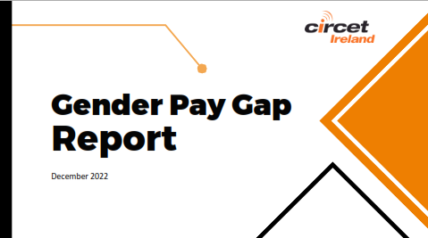

Slide 11
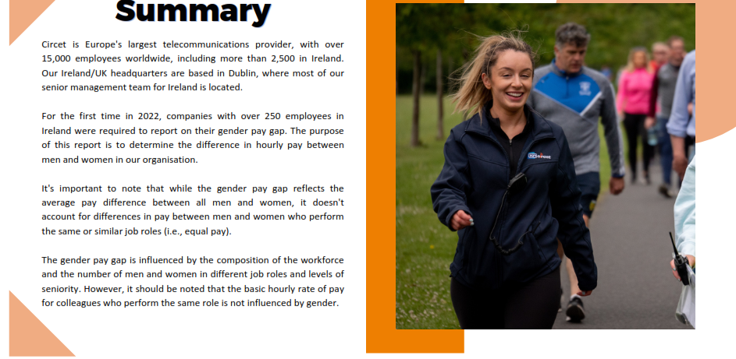

Slide 12
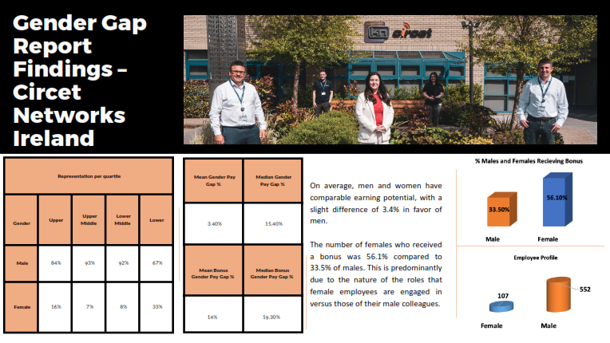

Slide 13
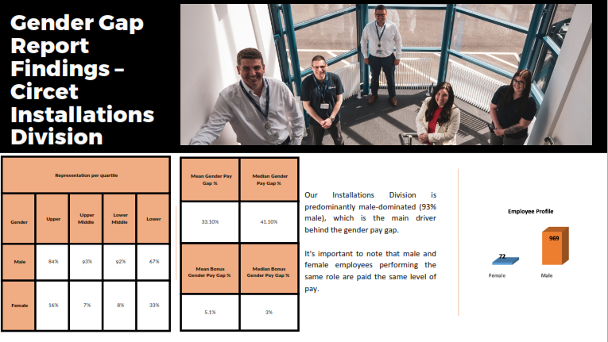

Slide 14
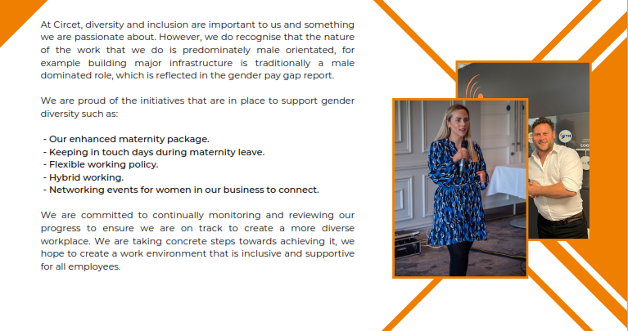

Slide 15
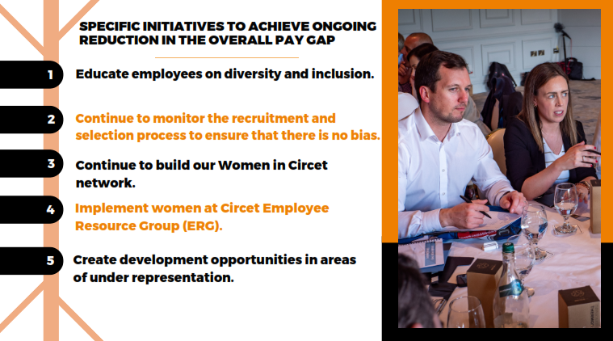

Slide 16


